Slide 1

https://resh.edu.ru/subject/lesson/1566/main/

Slide 2
The topic our lesson
«Proper nutrition. Selection of products.»

Slide 3

New words

Slide 4
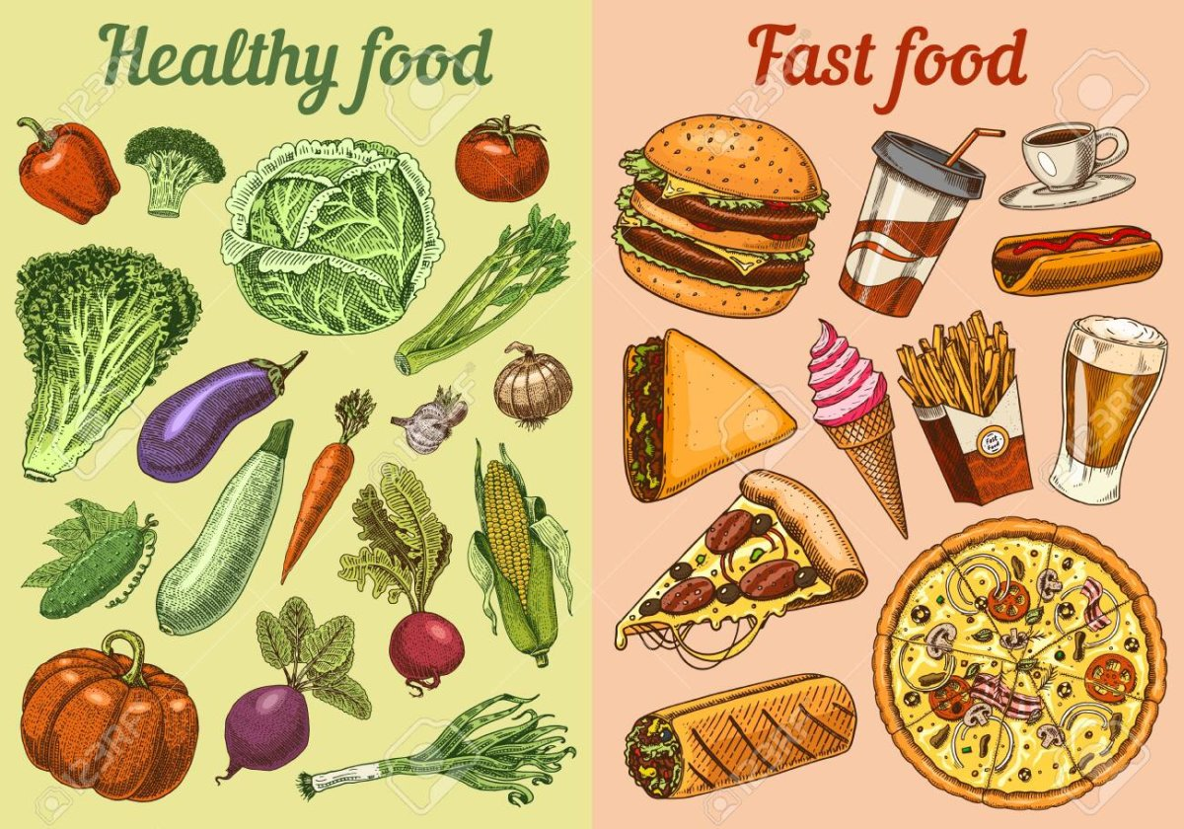

Slide 5
Phonetic exercise
Thirty days has September,
April, June and November.
February has twenty-eight alone.
All the rest have thirty-one,
But leap year coming once in four
Gives February one day more.

Slide 6
Match the proverbs.
1 Time is… | A - …is worth two in the evening.
2 Time cures … | B - …with the lamb and rise with the lark.
3 There is a … | C - …a great healer.
4 Go to bed … | D - …early to rise makes a man healthy, wealthy and wise.
5 An hour in the morning … | E - …all things.
6 Wealth is … | F - …salve for every sore.
7 Early to bed … | G - …nothing without health.

Slide 7
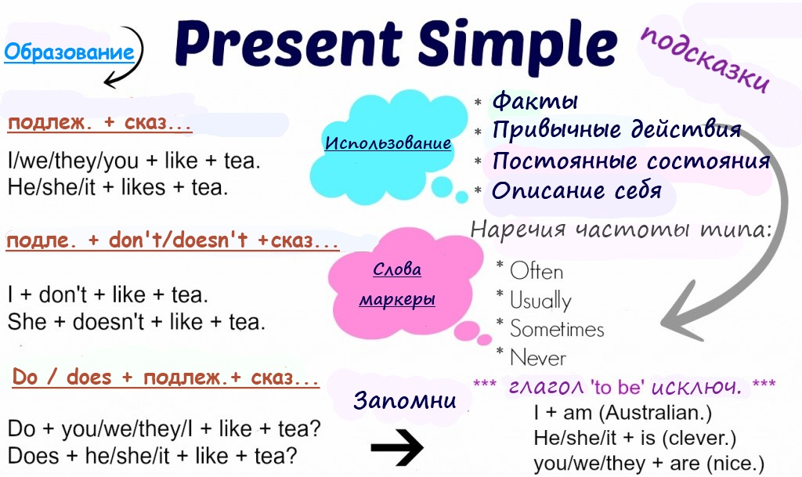

Slide 8
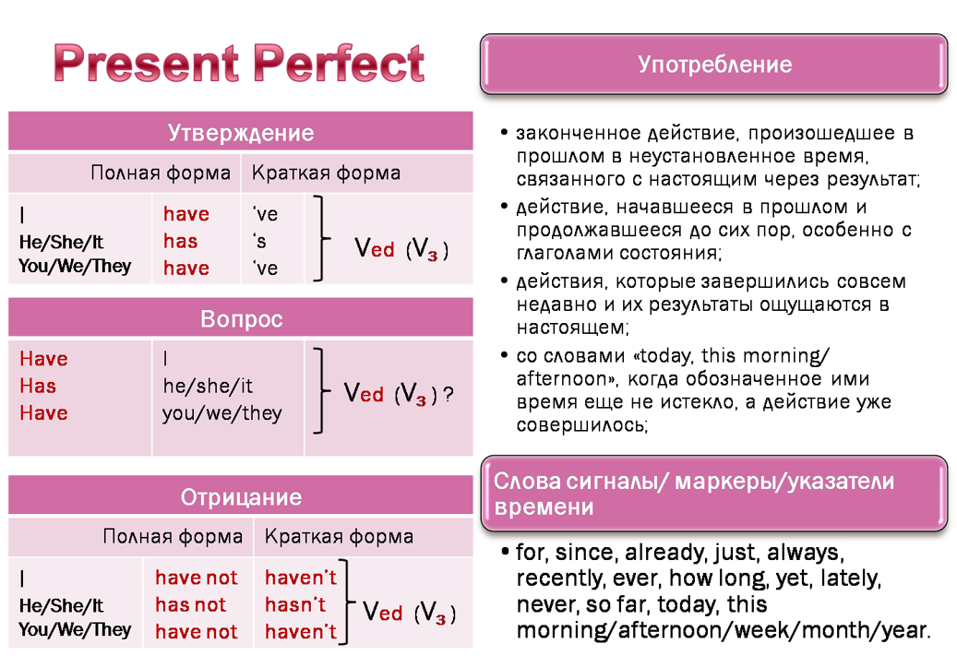

Slide 9
Упражнение 1. Поставьте глаголы в скобках в Present Perfect.
He _____ (finish) training.
She _____ (score) twenty points in the match.
We _____ (watch) all the Champions League matches this season.
That's amazing! She _____ (run) fifteen kilometers this morning!
She _____ (buy) some really nice rollerblades!
Oh, no! I _____ (lose) my money!
My mum _____ (write) shopping list. It's on the kitchen table.

Slide 10
Explain the idioms.
To feel under the weather (not to feel well, to be ill);
To feel run down (to be exhausted);
To look off colour (to look pale);
To drop like flies ( to get ill in very large numbers).

Slide 11
Choose True, False or Not given
1) Speaker: Many people in eastern world eat the wrong food.
False
True
Not given
2) Speaker: I do not have any idea for improving the situation.
True
Not given
False
3) Vegetarians think meat is unhealthy food.
True
False
Not given
4) Cabbage contains unique and useful elements for our health.
Not given
True
False
5) Speaker: The amount of food is also important.
Not given
False
True
https://english-rooms.com/test/pre-intermediate-listening-test-healthy-eating

Slide 12
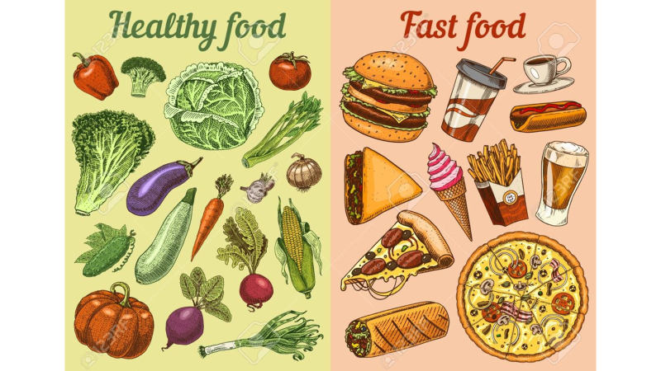
What do you like to eat for breakfast ?
What do you normally like to eat for breakfast ?

Slide 13
Tanya | Hello, Natasha! Do you always visit this supermarket?
Natasha | Nice to see you, Tanya! I often buy here food.
Tanya | I see you have bought oatmeal, cabbage, artichoke, carrot, bananas and oranges.
Natasha | Yes. I think what we eat is very important for our health and that's why I choose what is best for me.
Tanya | I know, you are keen on diets and healthy food. What about pizza, sandwiches, and Cola?
Natasha | I never buy them. They could be dangerous for our health.
Tanya | I see. Oatmeal is not dangerous but also is not very tasty.
Natasha | I do not think so. I eat it every morning with pleasure. As I cook it with bananas, peaches, raspberries or strawberries, it is very tasty.
Tanya | Sounds really tasty. I think, I will cook oatmeal tomorrow and see whether you are right.
Natasha | If you eat it every day, you will keep fit and be full of energy, you will be always in a good mood. And try to eat more fruits and vegetables and drink juice instead of coffee.
Tanya | Thanks for your advice. See you later!
Natasha | Goodbye!

Slide 14
Do you look after yourself?
How many hours per night do you sleep?
a) Under 6 hours b) about 7 or 8 hours c) more than 9 hours
How often do you clean your teeth?
a) Once a day b) twice a day c) after every meal
How often do you do physical exercise?
a) Never b) once a week c) two or three times a week
How often do you eat sweets or chocolate?
a) Never b) occasionally(иногда) c) quite a lot (довольно много)
How many pieces of fresh fruit do you eat per day?
a) One or two b) more than two c) none (ни одного)

Slide 15
Find the odd word and cross it out.
bacon, beef, turkey, pork, lamb,
carrot, melon, onion, cabbage, potatoes,
grapes, apple, pear, plum, nut,
beer, lemonade, tea, sugar, coffee,
ice-cream, toast with jam, pea-soup, cake.

Slide 16
Homework
-make a story about your diet 8-10 sentences. Use new words.
-make a recipe from healthy foods.
-SB,p.66,ex.3

