Slide 1
Make a meal of it!
Авдеева Дарья Валерьевна
МБОУ «Трехозерская СОШ»

Slide 2
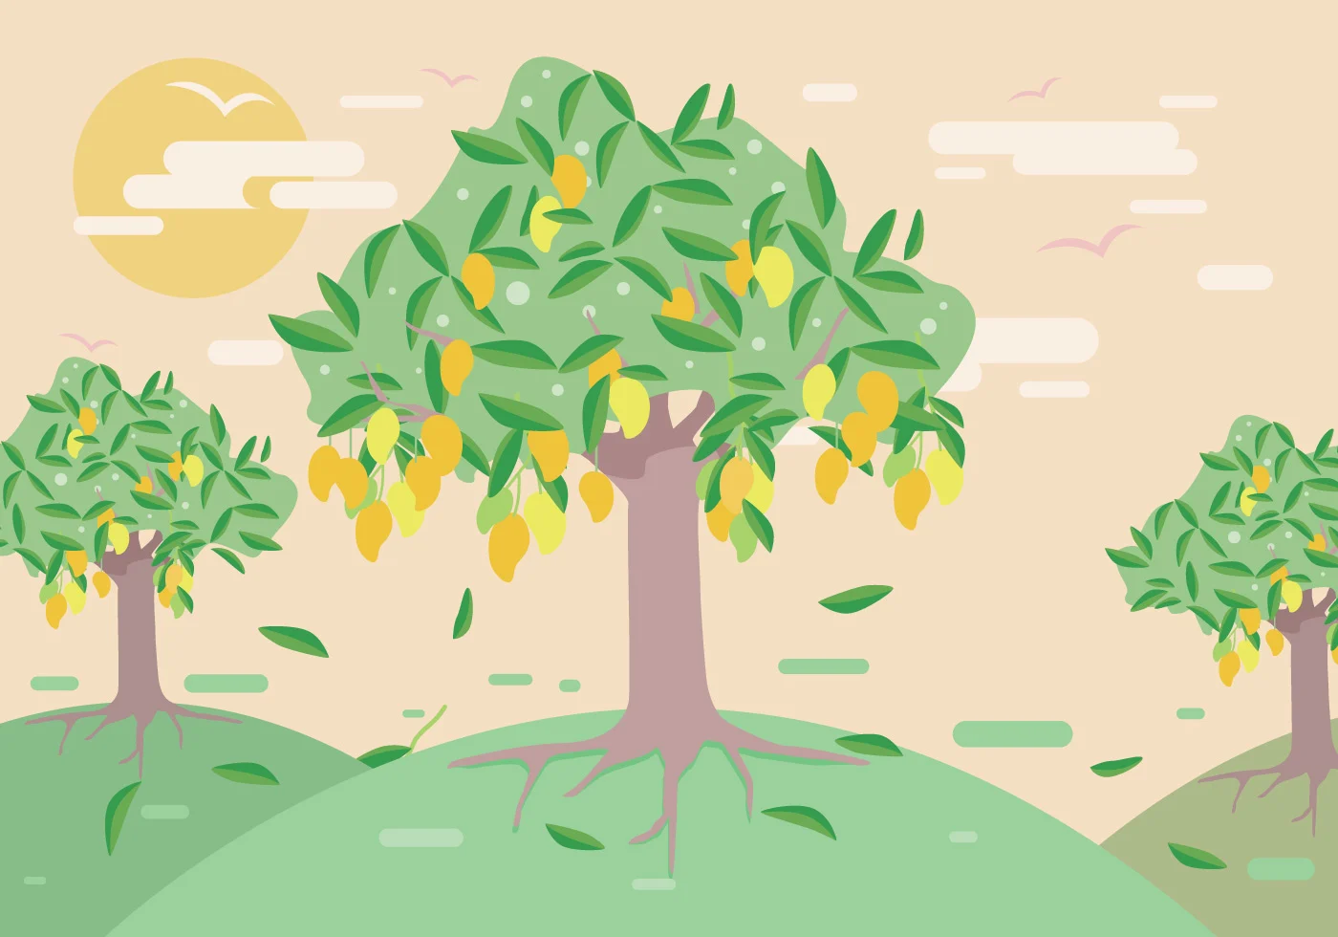
Tongue-twister
In the magic garden there are lots of oranges on the green mango tree.

Slide 3
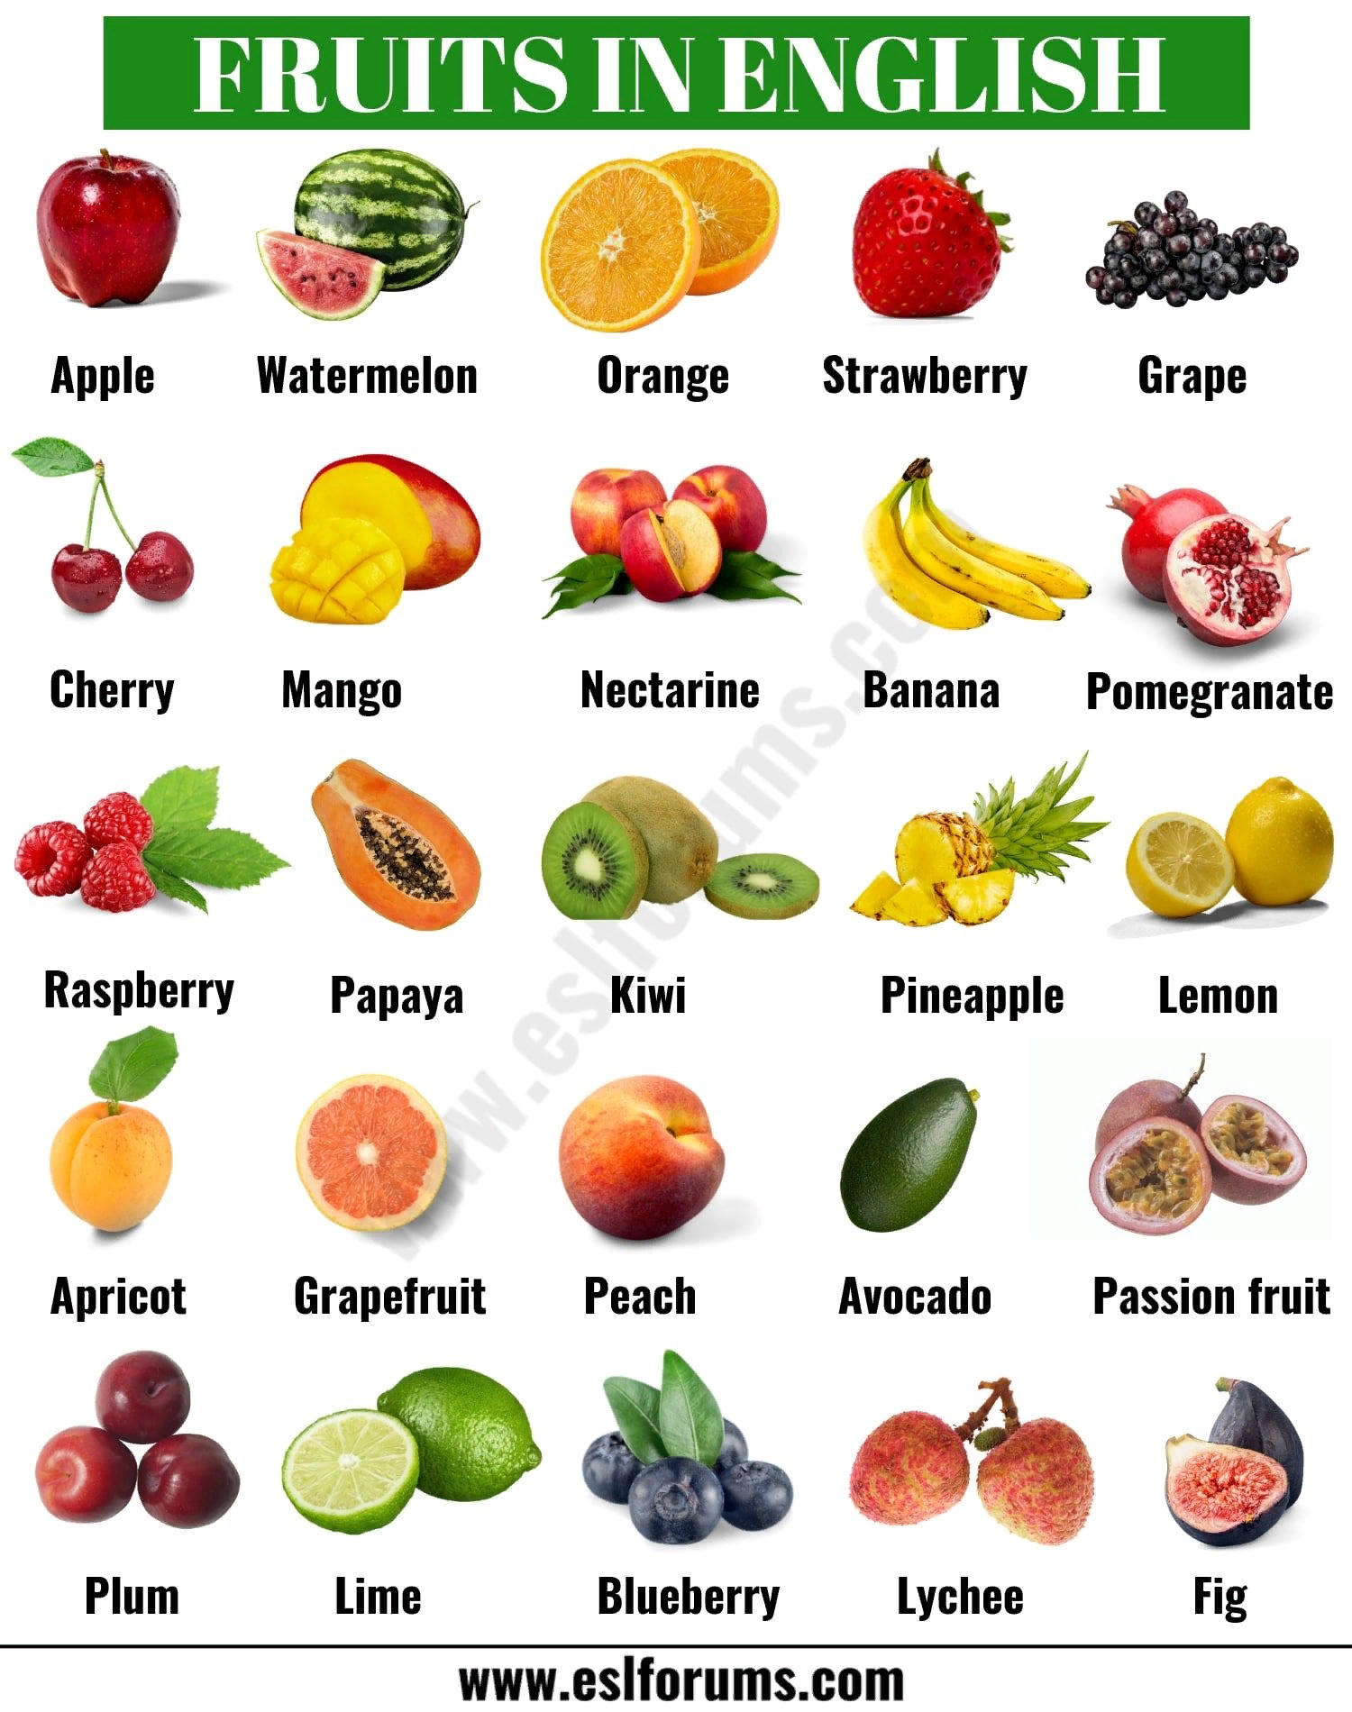
Прием «Да-нетка»
Examples of questions:
Is it delicious?
Is that fruit?
Is that an apple?
Is it red?
Does it have a smell?
Is it a vegetable?

Slide 4
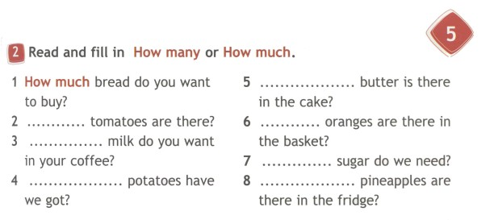
Checking homework
Correct answers.
How much.
How many.
How much.
How many.
How much.
How. many.
How much.

Slide 5
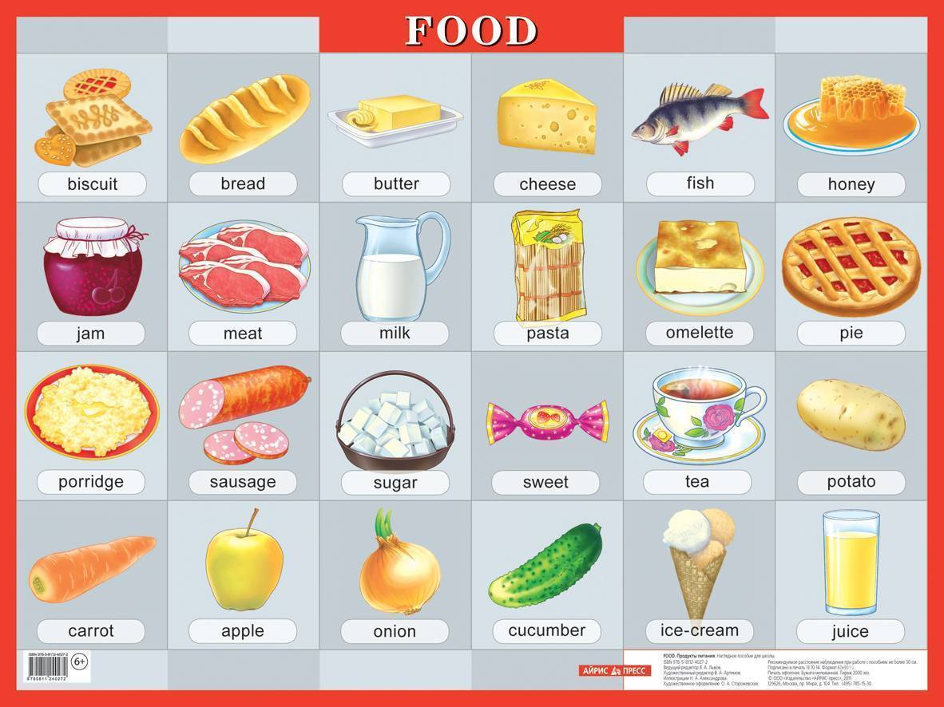
Product image cards

Slide 6
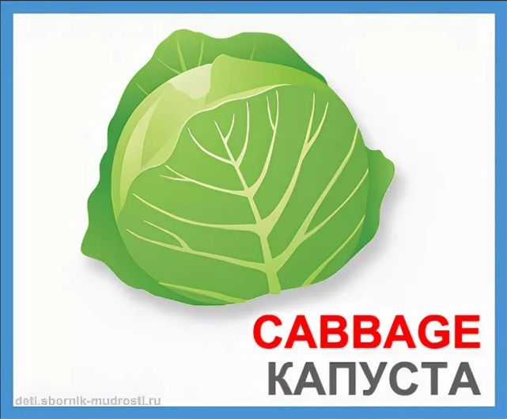
The "Associative series" technique
For example:
Cabbage.
Green, vegetable, round.
Cabbage is a round-shaped and green-colored vegetable.
There is a lot of cabbage in the garden and in the store.

Slide 7
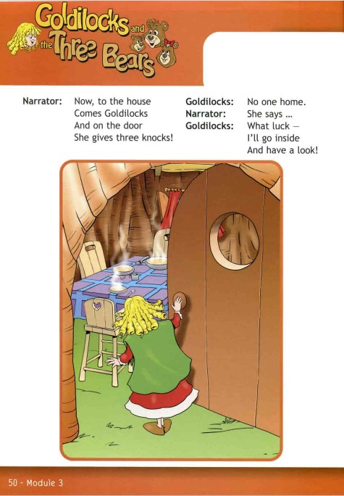
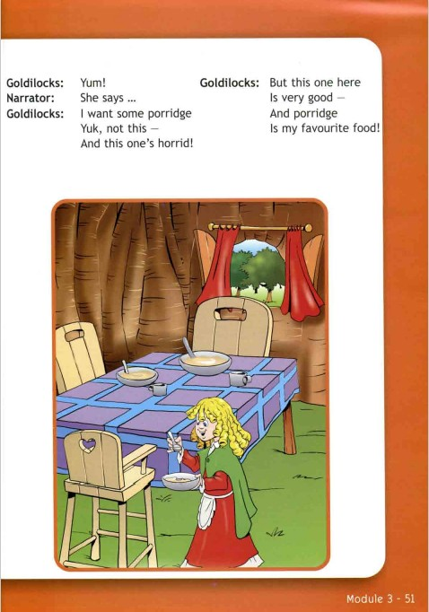


Slide 8
Words and their translation
knock - стучать, стук
luck - удача
inside - внутри
horrid - страшный, ужасный

Slide 9
Динамическая пауза
We'll jump so high, high, high,
We'll touch the sky, sky, sky.

Slide 10

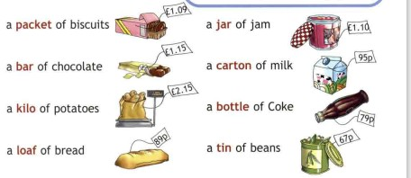
«Let’s shop»

Slide 11
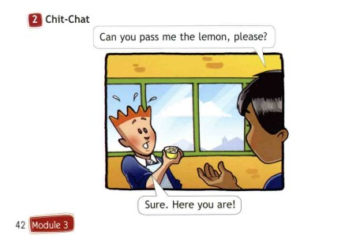
Dialogue

Slide 12
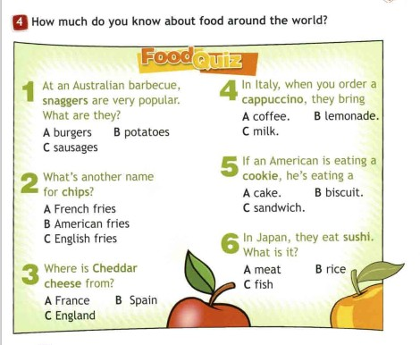


Slide 13
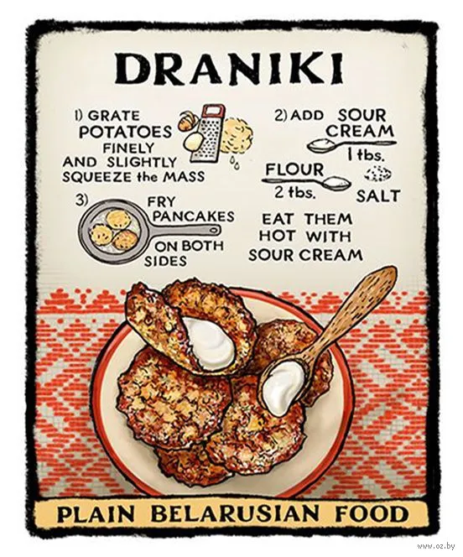
Recipe of the dish
Draniki (Potato pancakes)
Ingredients:
500 g of peeled potatoes;
2 tablespoons of flour;
1 onion;
1 egg;
2 tablespoons of oil;
2–3 tablespoons of milk;
salt (about ¾ of a teaspoon);
pepper.
Instructions

Slide 14
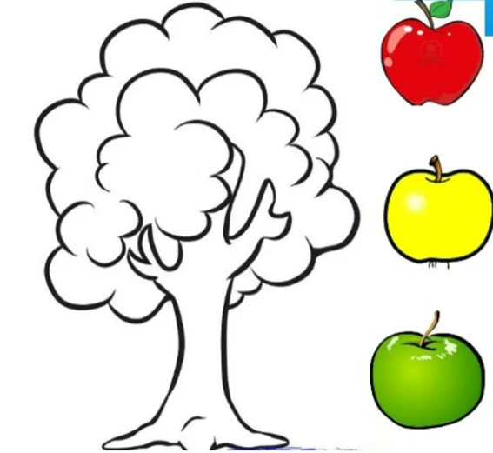
Success Tree

Slide 15
Great job! See you soon!

