Slide 1
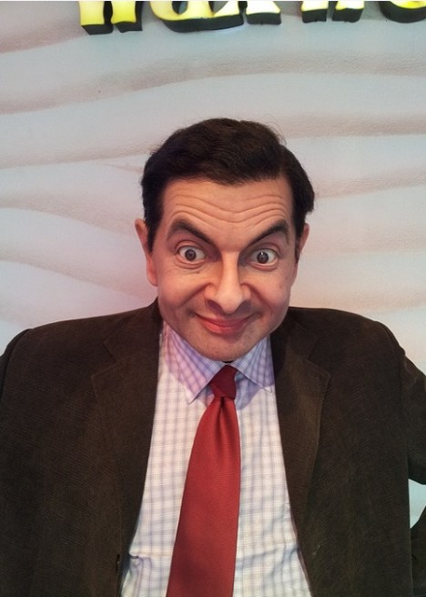
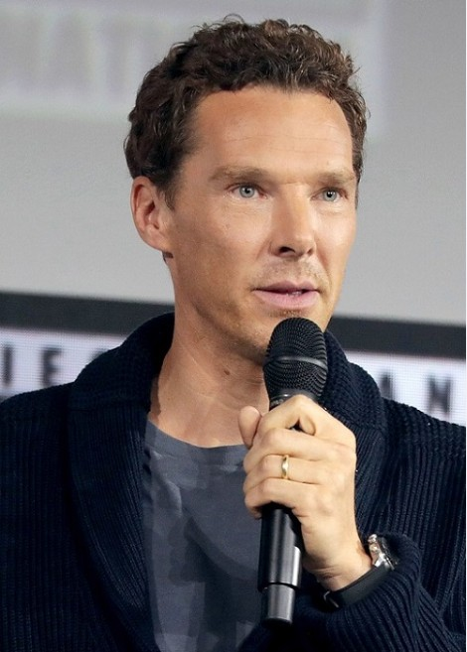
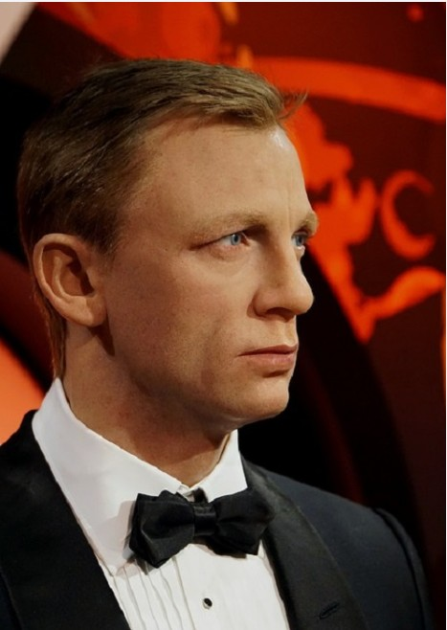
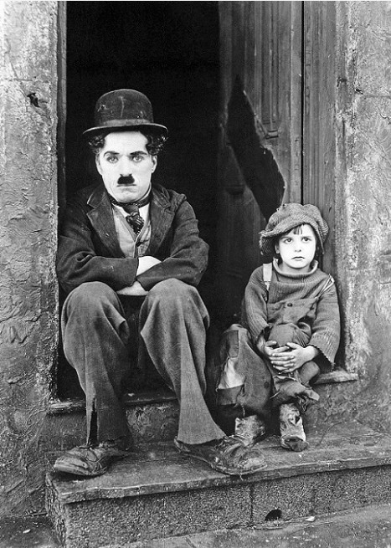
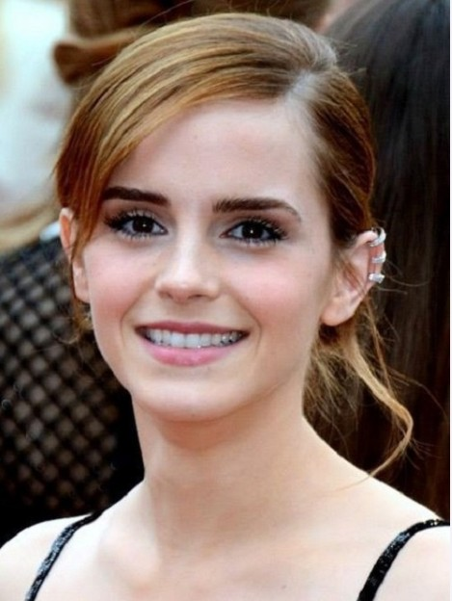
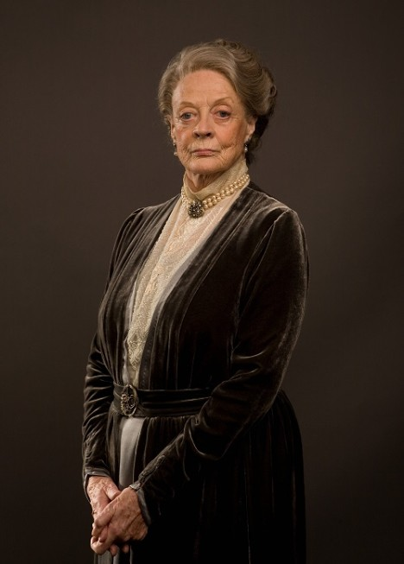

Slide 2
The topic our lesson: “Actors and actresses”

Slide 3
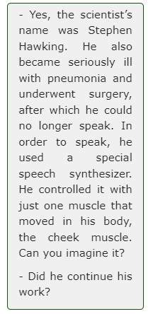
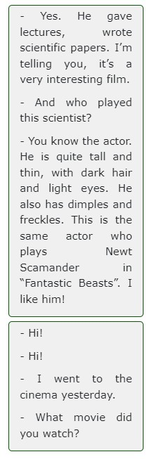
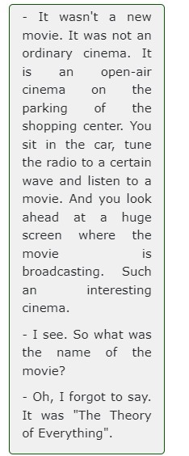
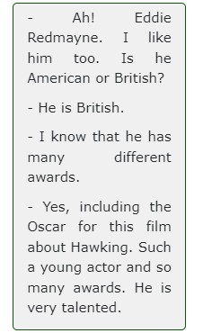
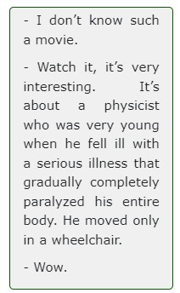
Put the parts of the dialogue in the correct order.
What is it about?

Slide 4
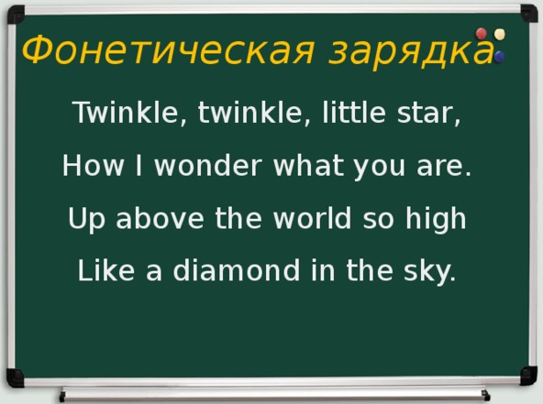

Slide 5
New words!
Awards-награды
Actor-актер
Including-включая, включающий
Certain –определенный
Ordinary-обычный
Broadcasting-трансляция
Open-air-под открытым небом
Tune-мелодия

Slide 6
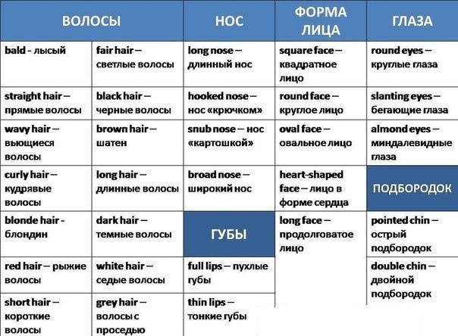

Slide 7
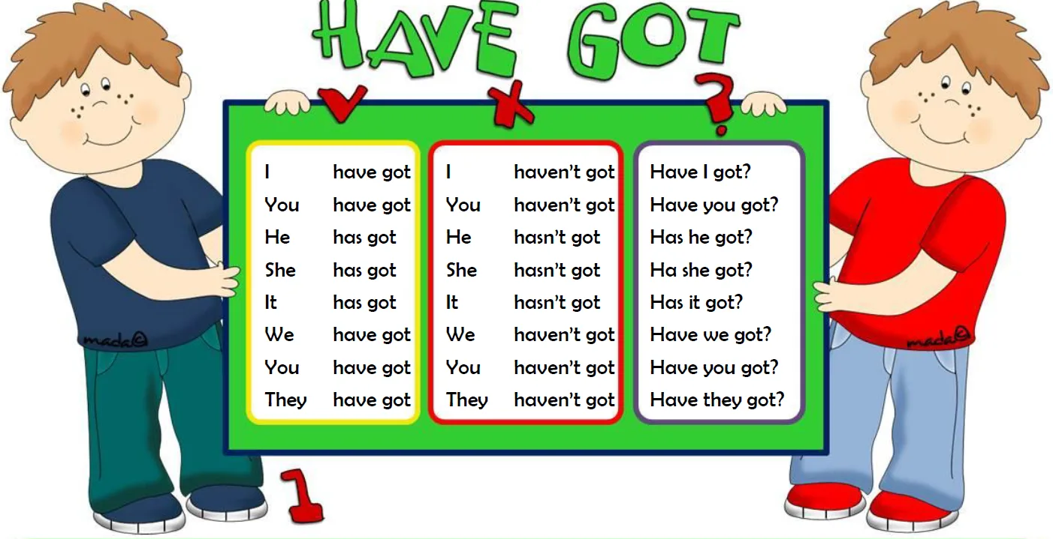
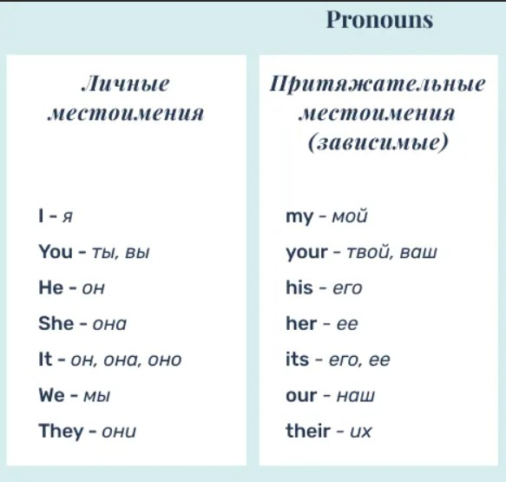
А:Have you got a favorite actor or actress?
B:Yes,I have./No,I haven’t.
А:What's his name?
В:His name is Eddie Redmayne.

Slide 8
Describe the appearance of the actress
She has got…
Maggie Smith

Slide 9

Listen to the dialogue. Decide if the statements are True or False.
Eddie Redmayne is an American actor.
Eddie Redmayne has fair hair and freckles.
Eddie Redmayne is tall.
Eddie Redmayne has dark hair and dimples.
Eddie Redmayne is fat.
Eddie Redmayne is a talented actor who has many awards.

Slide 10
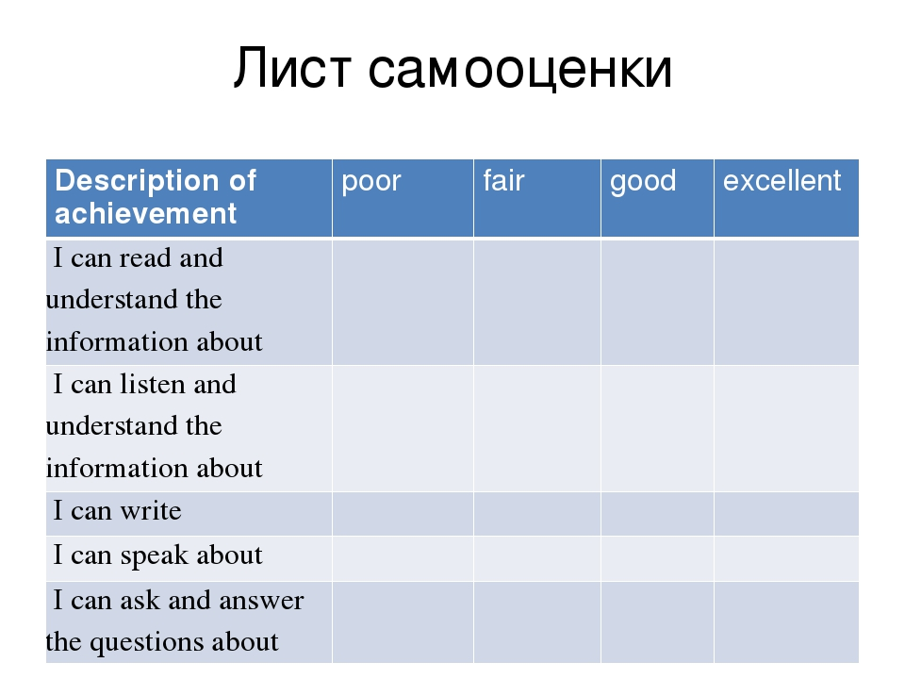

Slide 11
Homework.
1.Write a short report about your favourite actor or actress (50-60 words).
2. Create a True\False exercise about your favorite actor.
3.Student Book p.30,ex.2a,b.

